Slide 1
Loops and Regular Expressions Creating Loops with while and for, Different versions of Loops, Nested Loops, Loop Control Statements, Loop Modification with break, continue and pass, Regular Expressions.

Slide 2

Loops in Python
Python has two primitive loops
While
for
T Seshu Chakravarthy Department Of Computer Science and Engineering

Slide 3
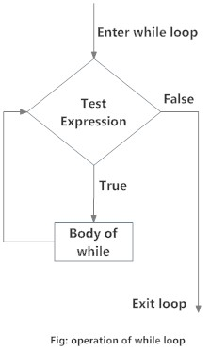
The while Loop
Syntax:
while test_expression:
Body of while
while loop executes a block of statements repeatedly till a given a condition is true. when the condition becomes false, it terminates the body of the loop.
In Python, the body of the while loop is determined through indentation.
T Seshu Chakravarthy Department Of Computer Science and Engineering

Slide 4
loop to print numbers from 1 to 10
i = 1
# Use a while loop to print numbers from 1 to 10
while i <= 10:
print(i)
i=i+1
Output:
1
2
3
4
5
6
7
8
9
10
T Seshu Chakravarthy Department Of Computer Science and Engineering

Slide 5
write a Python program to calculate the sum of the digits of a number
num = int(input("Enter a number: "))
sum = 0
while num > 0:
digit = num % 10 # Extract the last digit
sum=sum+digit
num= num//10 # Remove the last digit from the number
print("Sum of digits:", sum)
Output:
Enter a number: 127
Sum of digits: 10
T Seshu Chakravarthy Department Of Computer Science and Engineering

Slide 6
write a Python program to check if a number is a palindrome or not
num = int(input("Enter a number: "))
original_num = num
reversed_num = 0
while num > 0:
digit = num % 10
reversed_num = reversed_num * 10 + digit
num = num // 10
# Check if the original number is equal to the reversed number
if original_num == reversed_num:
print("The number is a palindrome.")
else:
print("The number is not a palindrome.")
Note:
A palindromic number is a number that remains the same when its digits are reversed.
Ex: 121, 1331, 5555, 12321
Output:
Enter a number: 1331
The number is a palindrome.
Enter a number: 1234The number is not a palindrome.
T Seshu Chakravarthy Department Of Computer Science and Engineering

Slide 7
Using else statement with while loops:
The else clause is only executed when your while condition becomes false.
If you break out of the loop, or if an exception is raised, it won’t be executed.
Syntax:
while condition:
# execute these statements
else:
# execute these statement
T Seshu Chakravarthy Department Of Computer Science and Engineering

Slide 8
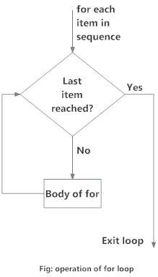
for loop
A for loop is used for iterating over a sequence(list, tuple, string)
for loop can execute a set of statements(Body), once for each item in a list
Syntax of for Loop
for variable in sequence:
Body of for
Here, variable takes the value of the item inside the sequence on each iteration.
Loop continues until it reach the last item in the sequence.
T Seshu Chakravarthy Department Of Computer Science and Engineering

Slide 9
# Program to find the sum of all numbers stored in a list#
numbers = [6, 5, 3, 8]
sum = 0
for i in numbers:
sum = sum+i
print("The sum is", sum)
Output:
The sum is 22
T Seshu Chakravarthy Department Of Computer Science and Engineering

Slide 10
Ex: Program to count the vowels in a list
text = “University"
vowels = "aeiouAEIOU"
vowel_count = 0
for char in text:
if char in vowels:
vowel_count += 1
print("Vowel count:", vowel_count)
Output:
Vowel count: 4
T Seshu Chakravarthy Department Of Computer Science and Engineering

Slide 11
range() function
It generates a sequence of numbers.
range(10) will generate numbers from 0 to 9 (10 numbers).
We can also define the start, stop and step size as range(start,stop,step size)
step size defaults to 1 if not provided.
list() function output all the items in the range.
print(list(range(10))) # Output: [0, 1, 2, 3, 4, 5, 6, 7, 8, 9]
print(list(range(2, 8))) # Output: [2, 3, 4, 5, 6, 7]
print(list(range(2, 20, 3))) # Output: [2, 5, 8, 11, 14, 17]
T Seshu Chakravarthy Department Of Computer Science and Engineering

Slide 12
# Python Program find even and odd numbers in between 1 to n
n=int(input("enter number"))
# Initialize empty lists to store even and odd numbers
even_numbers = []
odd_numbers = []
# Iterate through the list and categorize the numbers
for num in range(1,n):
if num % 2 == 0:
even_numbers.append(num)
else:
odd_numbers.append(num)
print("Even numbers:", even_numbers)
print("Odd numbers:", odd_numbers)
Output:
enter number 6
Even numbers: [2, 4]
Odd numbers: [1, 3, 5]
T Seshu Chakravarthy Department Of Computer Science and Engineering

Slide 13
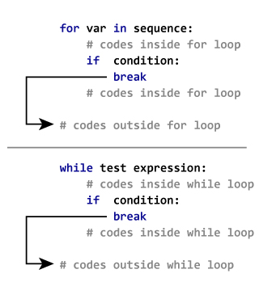
Python break and continue
In Python, break and continue statements can alter the flow of a loop.
Python break statement:
The break statement is used to exit a loop prematurely when a certain condition is met.
When break is encountered inside a loop, the loop is terminated, and the program continues with the next statement after the loop.
T Seshu Chakravarthy Department Of Computer Science and Engineering

Slide 14
Python break
Example-1:
for i in range(1,11):
if i == 4:
break
print(i)
print("It display values before",i)
Example-2:
for val in "VVIT-AP":
if val == "A":
break
print(val)
Output:
V
I
T
-
Output:
1
2
3
It display values before 4
T Seshu Chakravarthy Department Of Computer Science and Engineering

Slide 15
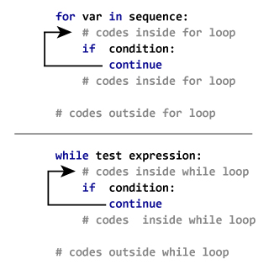
Python continue statement
The continue statement is used to skip the current iteration of a loop and move to the next iteration, without executing the remaining code in the loop for the current iteration.
It's useful when you want to skip certain iterations based on a condition but continue the loop overall
T Seshu Chakravarthy Department Of Computer Science and Engineering

Slide 16
Python continue statement
Example-1:
for i in range(1,11):
if i == 4:
continue
print(i)
Example-2:
for val in "VVIT-AP":
if val == "A":
continue
print(val)
1
2
3
5
6
7
8
9
10
V
I
T
-
P
T Seshu Chakravarthy Department Of Computer Science and Engineering

Slide 17
Python pass statement
The pass statement is a null operation; nothing happens when it executes.
It indicates no operation (NOP).
So, we use the pass statement to construct a body that does nothing.
Ex:
sequence = {‘a', ‘b', ‘c'}
for val in sequence:
pass
print ("good bye")
T Seshu Chakravarthy Department Of Computer Science and Engineering

Slide 18
Python Nested Loops
Nested loops mean loops inside a loop.
For example, while loop inside the for loop, for loop inside the for loop, etc.
Python Nested Loops Syntax:
Outer_loop Expression:
Inner_loop Expression:
Statement inside inner_loop
Example:
x = [1, 2]
y = [4, 5]
for i in x:
for j in y:
print(i, j)
1 4
1 5
2 4
2 5
T Seshu Chakravarthy Department Of Computer Science and Engineering

Slide 19
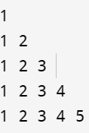
Right Half Pyramid Pattern
n=int(input("enter n"))
for i in range(1, n+1):
for j in range(1, i + 1):
print(j,end=" ")
print()
Pattern Program in Python (with 30 Examples) (tutorialstonight.com)
T Seshu Chakravarthy Department Of Computer Science and Engineering

Slide 20
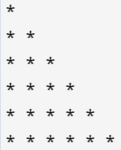
Right Half Pyramid star pattern
n=int(input("enter n"))
for i in range(1, n+1):
for j in range(1, i + 1):
print(“*”,end=" ")
print()
T Seshu Chakravarthy Department Of Computer Science and Engineering

Slide 21
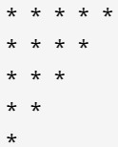
Inverted Right Half Pyramid star pattern
n= 5
for i in range(n, 0, -1):
for j in range(1, i + 1):
print("* ", end="")
print()
T Seshu Chakravarthy Department Of Computer Science and Engineering

Slide 22
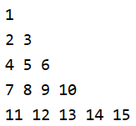
n=5
x=0
for i in range(1, n+1):
for j in range(1, i + 1):
x=x+1
print(x, end=" ")
print()
T Seshu Chakravarthy Department Of Computer Science and Engineering

Slide 23
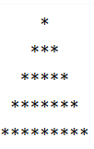
Full Pyramid Pattern in python
n = 5
for i in range(1, n+1):
for j in range(n - i):
print(' ', end='')
for k in range(2*i - 1):
print('*', end='')
print()
T Seshu Chakravarthy Department Of Computer Science and Engineering

Slide 24
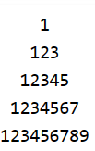
Number Pyramid Pattern Program In Python
n = 5
for i in range(1, n+1):
for j in range(n - i):
print(' ', end='')
for k in range(2*i - 1):
print(k+1, end='')
print()
T Seshu Chakravarthy Department Of Computer Science and Engineering

Slide 25
Python Program to Check Prime Number
A positive integer greater than 1 which does not have other factors except 1 and the number itself is called a prime number.
The numbers 2, 3, 5, 7, etc. are prime numbers as they do not have any other factors.
num = 152
if num > 1:
for i in range(2, num):
if (num % i) == 0:
print(num, "is not a prime number")
break
else:
print(num, "is a prime number")
else:
print(num, "is not a prime number")
152 is not a prime number
T Seshu Chakravarthy Department Of Computer Science and Engineering

Slide 26
Python Program to Check Armstrong number
An Armstrong number is a number that is equal to the sum of its individual digits each raised to the power of the number of digits.
For example, one of the smallest Armstrong numbers is 153:
The number has 3 digits.
The sum of each digit raised to the power of 3 is: 1^3 + 5^3 + 3^3 = 1 + 125 + 27 = 153.
n=int(input())
s = n
d= len(str(n))
sum = 0
while n != 0:
r = n % 10
sum= sum+(r**d)
n = n//10
if s == sum:
print("The given number", s, "is Armstrong number")
else:
print("The given number", s, "is not Armstrong number")
153
The given number 153 is Armstrong number
T Seshu Chakravarthy Department Of Computer Science and Engineering

Slide 27
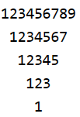
Reverse Number Pyramid Pattern Program In Python
size = 5
for i in range(size): # print spaces
for j in range(i):
print(" ", end="") # print numbers
for k in range(2 * (size - i) - 1):
print(k+1, end="")
print()
T Seshu Chakravarthy Department Of Computer Science and Engineering

Slide 28
Print the multiplication table for a given number
num = int(input("Enter an integer"))
for i in range(1, 11):
product = num * i
print(f"{num} x {i} = {product}")
Enter an integer
5
5 x 1 = 5
5 x 2 = 10
5 x 3 = 15
5 x 4 = 20
5 x 5 = 25
5 x 6 = 30
5 x 7 = 35
5 x 8 = 40
5 x 9 = 45
5 x 10 = 50
T Seshu Chakravarthy Department Of Computer Science and Engineering

Slide 29
Python program to display numbers up to a given value n that are divisible by both 3 and 7
n = int(input("Enter the value of n: "))
for num in range(1, n + 1):
if num % 3 == 0 and num % 7 == 0:
print(num)
T Seshu Chakravarthy Department Of Computer Science and Engineering

Slide 30
Python program to determine whether a given number is a perfect number or not
A perfect number is a positive integer that is equal to the sum of its proper divisors (excluding itself).
For example, 6 is a perfect number in Python because 6 is divisible by 1, 2, 3, and 6.
So, the sum of these values are 1+2+3 = 6 (Remember, we have to exclude the number itself. That’s why we haven’t added 6 here).
Some of the perfect numbers are 6, 28, 496, etc.
T Seshu Chakravarthy Department Of Computer Science and Engineering

Slide 31
Python program to determine whether a given number is a perfect number or not
num = int(input("Enter a number: "))
sum_of_divisors = 0
for i in range(1, num):
if num % i == 0:
sum_of_divisors += i
if sum_of_divisors == num:
print(f"{num} is a perfect number.")
else:
print(f"{num} is not a perfect number.")
Output:
Enter a number: 6
6 is a perfect number.
Enter a number: 10
10 is not a perfect number.
T Seshu Chakravarthy Department Of Computer Science and Engineering

Slide 32
Python program to print following pattern
5 4 3 2 1
4 3 2 1
3 2 1
2 1
1
n = 5
for i in range(n+1):
for j in range(n-i,0,-1):
print(j,end=' ')
print()
T Seshu Chakravarthy Department Of Computer Science and Engineering

Slide 33
Python program to print following pattern
n = 5
alpha = 65
for i in range(n+1):
# print spaces
for j in range(n - i):
print(" ", end="")
# print alphabets
for k in range(2 * i -1):
print(chr(alpha + k), end="")
print()
A
ABC
ABCDE
ABCDEFG
ABCDEFGHI
T Seshu Chakravarthy Department Of Computer Science and Engineering

Slide 34
Python program to sort list without using built-in methods(Bubble sort)
a = [64, 34, 25, 12, 22, 11, 9]
n = len(a)
for i in range(n):
for j in range(0, n - i - 1):
if a[j] > a[j + 1]:
t=a[j]
a[j] = a[j+1]
a[j+1]=t
print("Sorted array:",a)
Sorted array: [9, 11, 12, 22, 25, 34, 64]
T Seshu Chakravarthy Department Of Computer Science and Engineering

Slide 35
Regular Expressions
Python RegEx (w3schools.com)
T Seshu Chakravarthy Department Of Computer Science and Engineering

Slide 36
Write a Python program that matches a string that has an a followed by zero or more b's.
Write a Python program to find sequences of lowercase letters joined by an underscore.
import re
txt = "abacus"
patterns= 'ab*'
if(re.search(patterns,txt)):
print("Found a match!")
else:
print('Not matched!')
import re
text = "aba_cus"
patterns = '[a-z]_[a-z]'
if re.search(patterns, text):
print('Found a match!')
else:
print('Not matched!')
Found a match!
T Seshu Chakravarthy Department Of Computer Science and Engineering

Slide 37
Write a Python program that matches a string that has an 'a' followed by anything ending in 'b'.
Write a Python program that matches a word containing 'z'.
import re
text = "abaub"
patterns = 'a.*b$'
if re.search(patterns, text):
print('Found a match!')
else:
print('Not matched!')
import re
text = "The quick brown fox jumps over the lazy dog."
patterns = '\wz'
if re.search(patterns, text):
print('Found a match!')
else:
print('Not matched!')
Found a match!
T Seshu Chakravarthy Department Of Computer Science and Engineering

Slide 38
Write a Python program to extract year, month and date from an URL.
import re
url= "https://www.washingtonpost.com/news/wp/2016/09/02/odell/"
d=re.findall('/(\d{4})/(\d{1,2})/(\d{1,2})/', url)
print(d)
[('2016', '09', '02')]
T Seshu Chakravarthy Department Of Computer Science and Engineering

Slide 39
Validating Mobile number
import re
mobile = "9502734525"
pattern = "[789]\d{9}$"
if re.search(pattern, mobile):
print("Valid mobile:")
else:
print("Invalid mobile!")
T Seshu Chakravarthy Department Of Computer Science and Engineering

Slide 40
Validating Email Addresses
import re
email = "chvrr58@gmail.com"
pattern = "^[a-zA-Z0-9]+@[a-zA-Z0-9]+\.[a-zA-Z]{2,3}$"
if re.search(pattern, email):
print("Valid email address:")
else:
print("Invalid email address!!")
T Seshu Chakravarthy Department Of Computer Science and Engineering

Slide 41
to check for a number at the end of a string.
patterns ='.*[0-9]$’
Construct a regex that matches abc followed by zero to many digits (0-9).
abc\d*
Construct a regex that matches both gray and grey.
gr[ae]y
Construct a regex that matches br followed by any single character except for a new line and then 3.
br.3
Construct a regex that matches a word that starts with an uppercase letter followed by at least one lowercase letter, like “Apple”, “Banana”, or “Carrot”.
[A-Z][a-z]+
T Seshu Chakravarthy Department Of Computer Science and Engineering

Slide 42
Construct a regex that matches eight word characters (letter, digit, or underscore).
\w{8}
Construct a regex that matches one or more lowercase letters (a-z) followed by a space character and then two to four digits.
[a-z]+\s\d{2,4}
Construct a regex that captures strings that have two digits followed by a period and then four letters from a to z.
\d{2}\.[a-z]{4}
FIND OUT ALL OF THE WORDS, WHICH START WITH A CONSONANT
'\b[^aeiou0-9 ]\w+'
T Seshu Chakravarthy Department Of Computer Science and Engineering

Slide 43
FIND OUT ALL OF THE WORDS, WHICH START WITH A VOWEL.
import re
txt = “The rain in Spain"
x = re.findall(r"\b[aeiou]\w+", txt)
print(x)
T Seshu Chakravarthy Department Of Computer Science and Engineering

